Slide 1
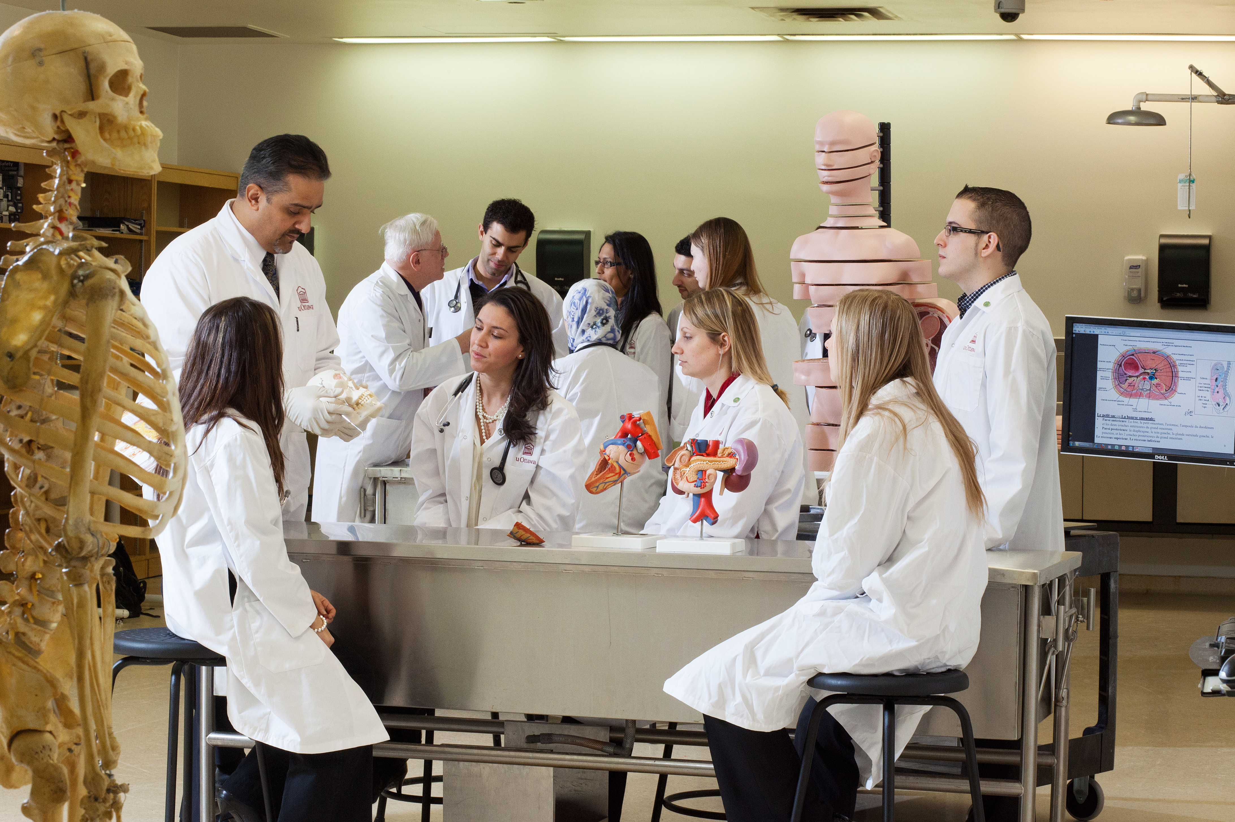


ANP 1105A - Anatomy & Physiology I
Basic Cellular Physiology & the Anatomy and Physiology of the Cardiovascular, Lymphatic & Respiratory Systems
Lecture 2A – Tissues
Presented by: Dr. Stephen Gee
Faculté de médecine | Faculty of Medicine
uOttawa.ca

Slide 2
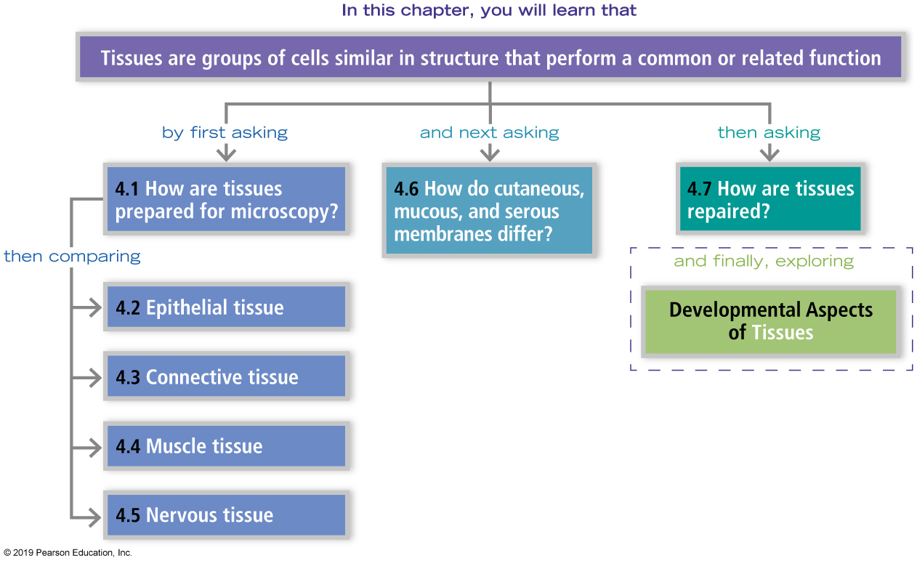
Tissue: The Living Fabric (Chapter 4, pages 116-137)
Don’t have issues, learn the tissues!
Notes:
Chapter 4, pages 116-137

Slide 3



Unicellular versus Multicellular Organisms
Unicellular
independently carry out all activities necessary for life
Multicellular
cells are specialized to perform specific tasks
Pros
Cons
Pros
Cons
Reproduce quickly
Rapidly respond to environmental change
Cannot grow very large
Short lifetimes
Usually must live in water
Need to live in food-rich environment
Nutrients must cross plasma membrane
Can grow very large - minimizes risk of becoming prey.
Can live in a variety of environments
Live longer than unicellular organisms
Work efficiently – cells are organized into tissues
Enable it to adapt, change and survive
Require more energy
Need to grow longer before reproduction
If one system fails, organism can die
Notes:
Read more about multicellular organisms and development:
https://www.microscopemaster.com/multicellular-organisms.html
https://www.futurelearn.com/courses/maths-power-laws/0/steps/12167

Slide 4

Test your knowledge
Why do multicellular organisms live longer?
Bigger
Less stress
Use more energy
Less toxic byproducts
30 second countdown timer – click to begin

Slide 5
Growth of a multicellular organism
We
begin life
as single cells
How do we get bigger?
What processes are needed to make us multicellular?
Proliferation – cell growth and division (mitosis)
Differentiation – specialization, cells with different structure and function.
Cell-cell interactions – direct and indirect
Cell migration

Slide 6
Test your knowledge
What limits the maximum size of single-celled organisms or single cells in a multicellular organism?
Available energy
Fragility of cell membrane
Diffusion
Toxic byproducts
30 second countdown timer – click to begin

Slide 7
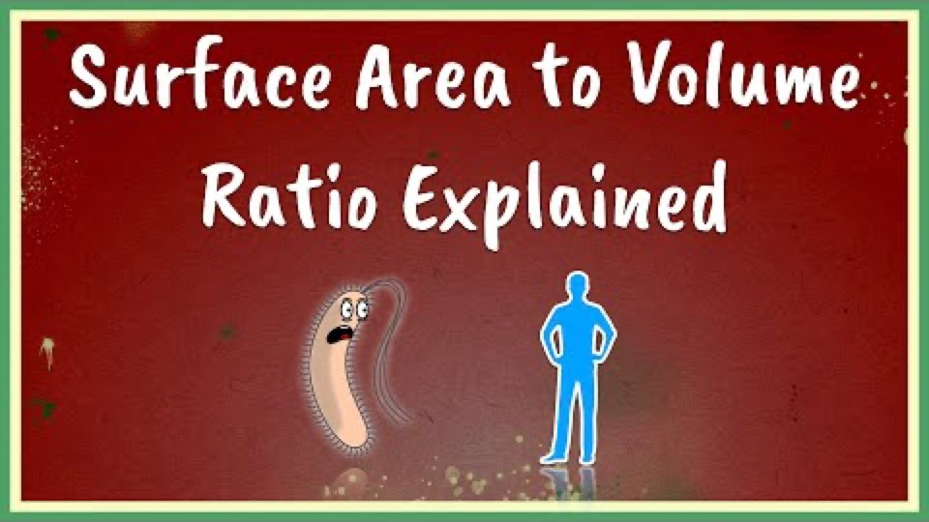
Why does diffusion limit cell size?

Slide 8
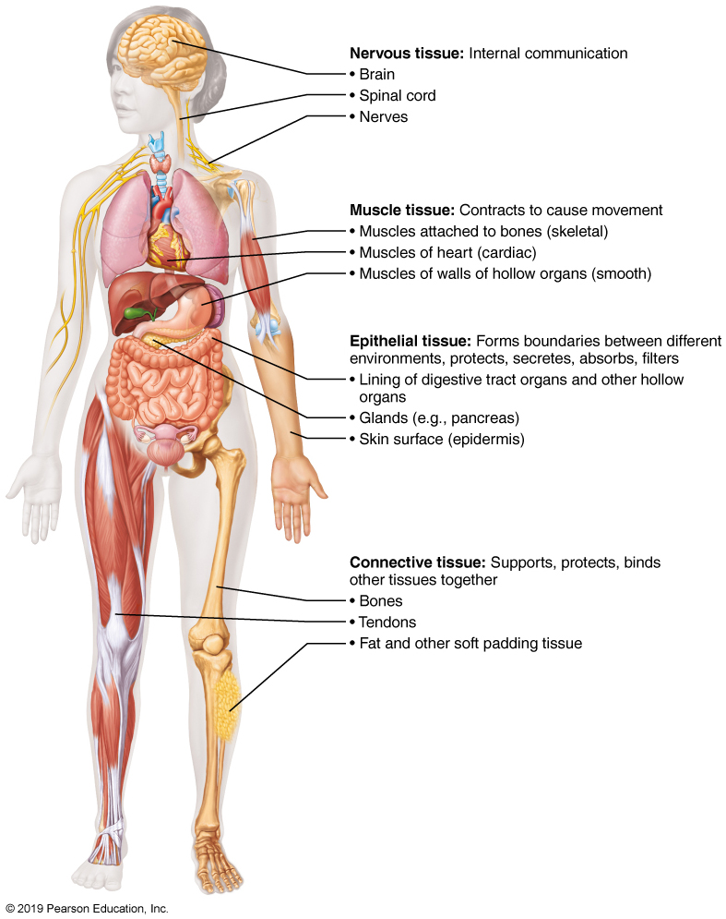

Tissues
Complex organisms, like humans, are made of collections of cells working together to perform a specific function.
Tissues
groups of cells similar in structure
common function
organized into organs
4 main tissue types
Figure 4.1 Overview of four basic tissue types: epithelial, connective, muscle, and nervous tissues.

Slide 9
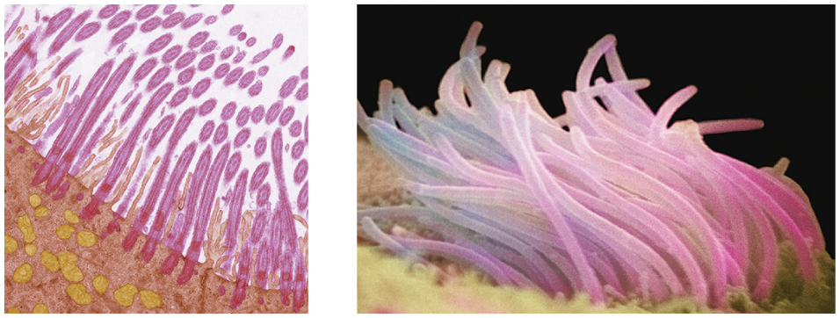
How do we study tissue structure?
Histology: study of tissues
Fixation or freezing
Cut into thin sections
Stained with dyes (light microscopy) – 1850s
or heavy metals (electron microscopy) – 1950s
or antibodies conjugated to dyes
Preservation induces artifacts
Nature Milestones – Light Microscopy
T.E.M.
S.E.M.
Notes:
This slide the students can learn on their own.

Slide 10
General Organization

Slide 11
Tissues
Tissues
groups of cells similar in structure
common function
organized into organs.
4 main tissue types
Figure 4.1 Overview of four basic tissue types: epithelial, connective, muscle, and nervous tissues.

Slide 12
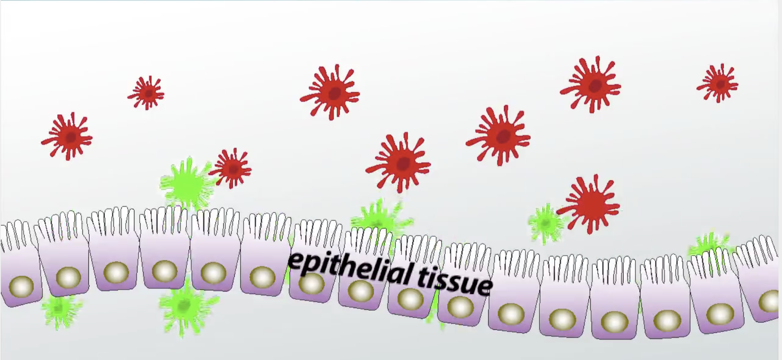
Epithelial Tissue (Epithelium)
Sheet of cells - covers body surfaces or cavities
e.g. surfaces of skin, digestive organs and respiratory tract
Covering and lining epithelia
On external and internal surfaces (e.g. skin)
Glandular epithelia
Secretory tissue in glands (e.g. salivary glands)
Selective barrier – e.g. intestinal epithelium allows passage of certain substances (e.g. nutrients) but not others (e.g. toxins, microorganisms)
bidirectional, highly regulated in healthy tissue and disease.
Gut microbiome! (we are mostly bacteria!)
Functions:
protection, absorption, filtration, excretion,
secretion, and sensory reception

Slide 13
Special Characteristics of Epithelial Tissues
Epithelial tissue has five distinguishing characteristics:
Polarity
Specialized contacts
Supported by connective tissues
Avascular, but innervated
Ability to regenerate

Slide 14
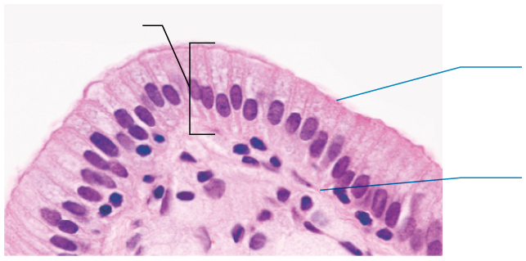

Special Characteristics of Epithelial Tissues
Polarity
Apical surface (top), is exposed to surface or cavity
Some apical surfaces are smooth, but many have microvilli or cilia
Basal surface (bottom), faces inwards toward body
Attaches to basal lamina, an adhesive sheet that holds basal surface of epithelial cells to underlying cells
Epithelium
Apical surface
Borders open space
Basal surface
Next to underlying connective tissue
Correct establishment and maintenance of cell polarity are
crucial for normal cell physiology and tissue homeostasis
Notes:
This image shows the brush border of intestinal epithelium, which features simple columnar epithelial cells with basal nuclear polarity and an apical surface with microvilli. Note the size of the microvilli relative to the cells that they cover.

Slide 15
Test your knowledge
What is the function of microvilli on epithelial cells in the small intestine?
Increase absorption
Sensory reception
Move substances
Attack pathogens
30 second countdown timer – click to begin

Slide 16
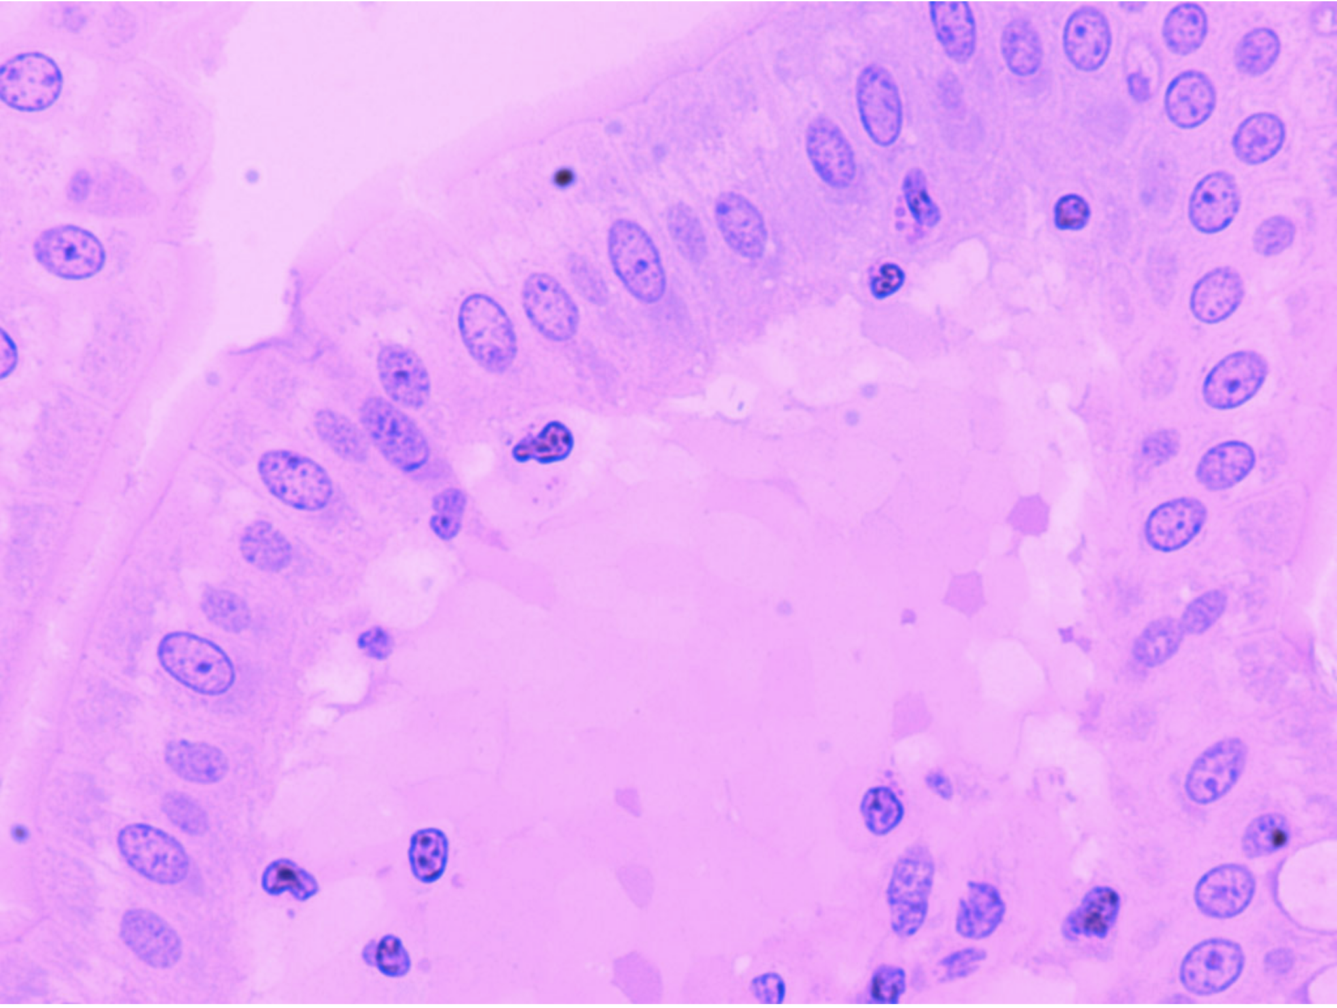

Brush Border Epithelia

Slide 17
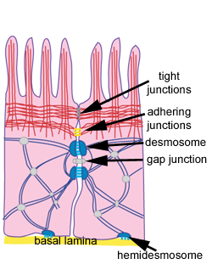
Special Characteristics of Epithelial Tissues
Intercellular Contacts
Epithelial cells need to fit closely together to form a barrier
Specialized contact points bind adjacent epithelial cells together
Lateral contacts include:
Tight junctions – prevents substances from leaking between cells (regulated) Directional flow of ions, nutrients, etc
Adherens junctions mediate cell-cell adhesion via proteins called cadherins.
Desmosomes – prevents cells from pulling apart in tissues subjected to mechanical stress – (Desmoglein)
Gap junctions - Intercellular communication mediated by connexins.
Notes:
Desmosomes are intercellular junctions of epithelia (and cardiac tissue)
resist mechanical stress

Slide 18
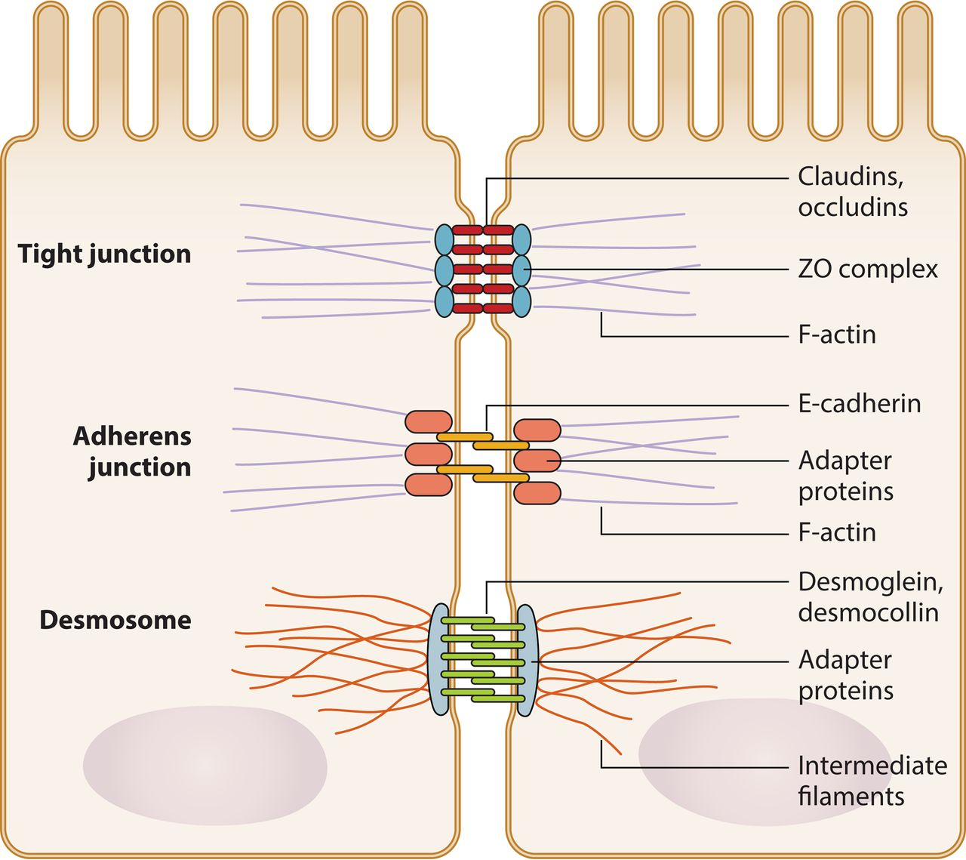
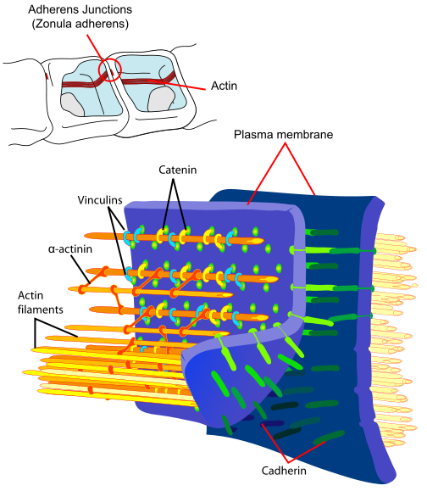
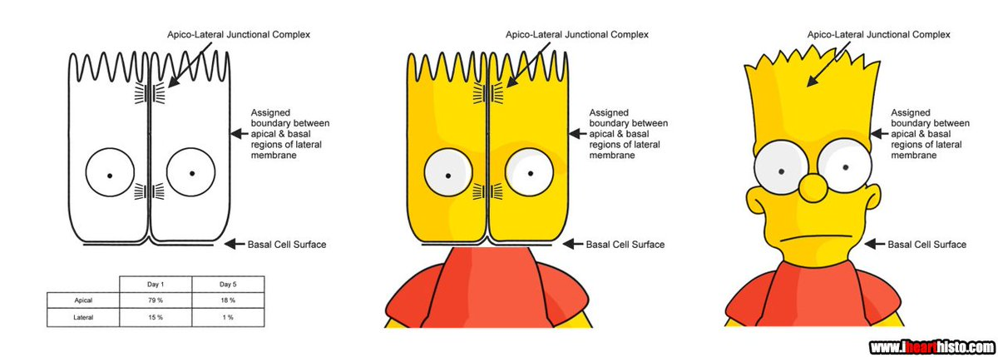
Specialized Intercellular Contacts
Apical
Pathogens
(reovirus, cocksackie virus)
“Belt-like”
Lateral
Cell junction have different connecting proteins
and attach to different filaments
Basal
Force
More about cell junctions
Notes:
Each of these intercellular adhesions can also act as signalling centres, regulating the availability of signalling molecules and thereby participating in fundamental processes such as cell proliferation, differentiation and morphogenesis.

Slide 19
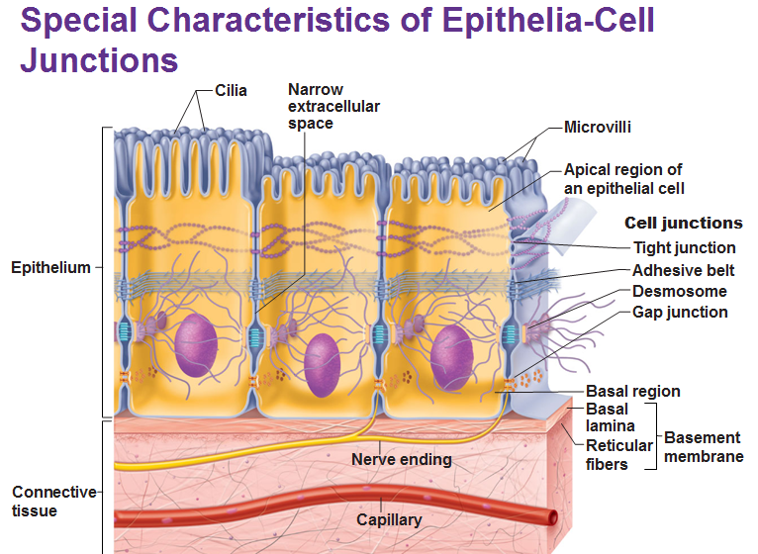
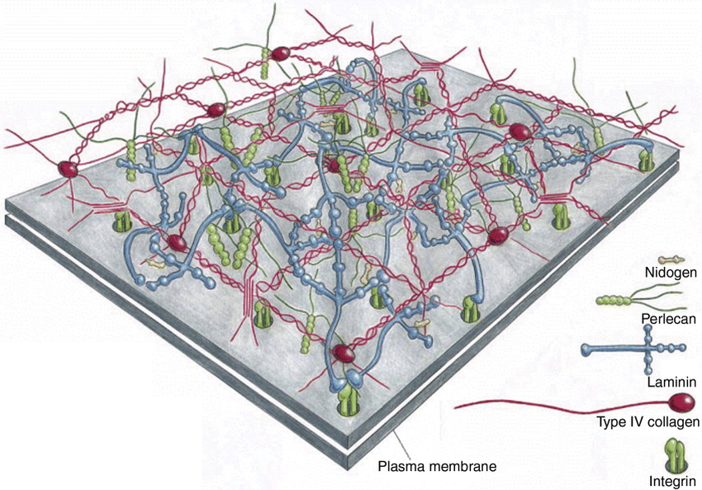
Special Characteristics of Epithelial Tissues
Supported by Connective Tissue
All epithelia have a basement membrane (BM)
Reinforces, resists stretching, tearing
Defines epithelial boundary
Consists of:
Basal lamina – layer of extracelluar matrix (ECM) proteins
Reticular lamina
Deep to basal lamina
Network of collagen (III) fibers
Disease Relevance: Cancerous epithelial cells can penetrate BM and invade underlying tissues, resulting in spread of cancer (metastasis) → 90% of cancer deaths
upside down!
Notes:
90% of the collagen in the body is in types I, II, III, and IV.
Type I is associated with (bONE).
Type II is associated with cartilage (carTWOilage).
Type III is associated with reticular fibers (reTHREEicular).
Type IV is associated with the floor (FOUR) or the basement membrane.

Slide 20
Special Characteristics of Epithelial Tissues
Avascular, but innervated
✗Blood vessels
Nutrients, O₂ diffuse from connective tissue
✓Nerves (e.g. sensory nerve ending in the skin)
Fun Fact: In one square inch of skin (including connective tissue) there are 4 yards of nerve fibers, 3 yards of blood vessels, 1300 nerve cells, 100 sweat glands, and 3 million cells

Slide 21
Special Characteristics of Epithelial Tissues
Regeneration
Epithelial cells - high regenerative capacities
Stimulated by loss of apical-basal polarity and broken lateral contacts
Some cells exposed to friction, hostile substances → damage
Must be replaced
Requires adequate nutrients and cell division
Wound healing
Q. Where do new epithelial cells come from?

Slide 22
Classification of Epithelia
Based on:
Number of cell layers (1 or more)
Shape of cells

Slide 23
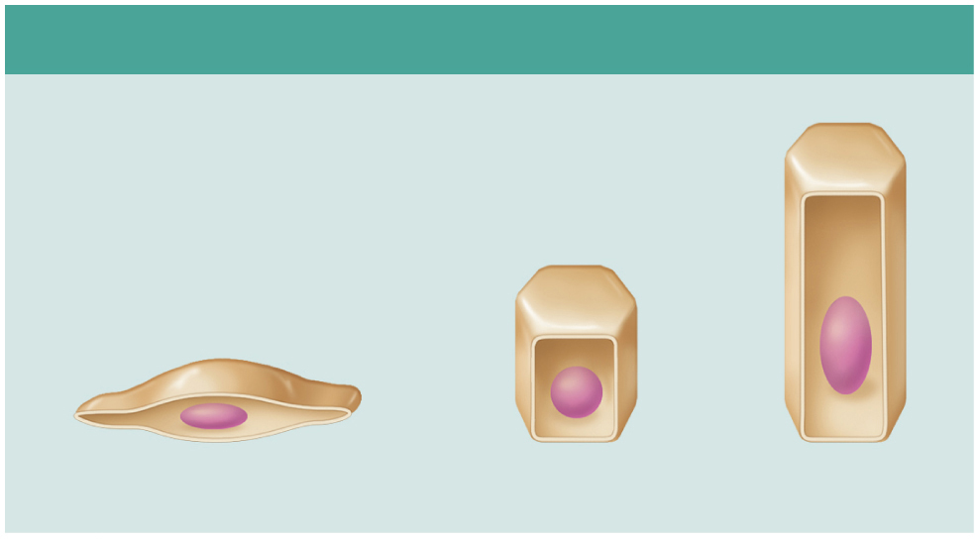
Classification based on Cell Shape
(b) Classification based on cell shape
Squamous
Cuboidal
Columnar
Squamous: flattened and scale-like
Cuboidal: box-like, cube
Columnar: tall, column-like
In stratified epithelia, shape can vary in each layer, so classified according to the shape in apical layer

Slide 24
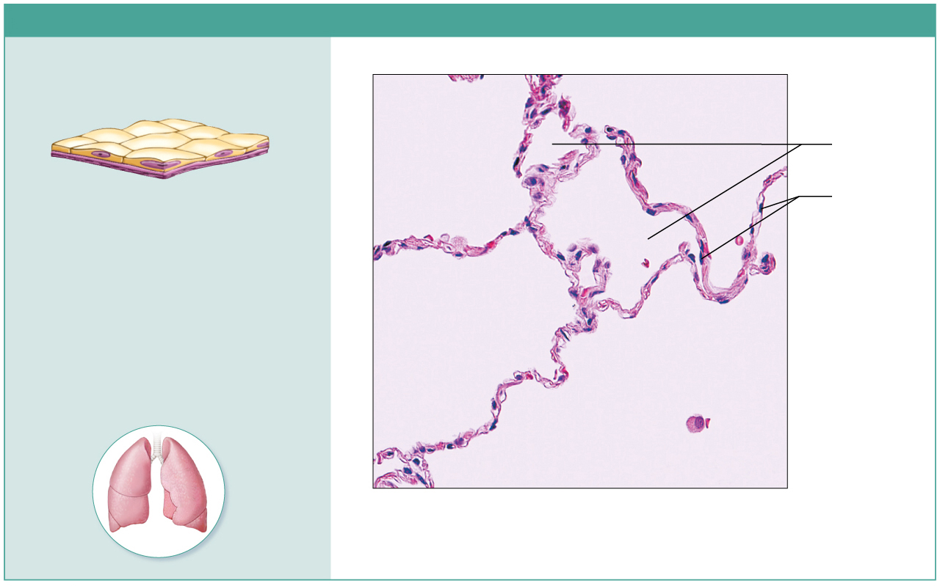
Epithelium: Simple Squamous
(a) Epithelium: simple squamous
Description: Single layer of flattened cells
with disc-shaped central nuclei and sparse
cytoplasm; the simplest of the epithelia.
Air sacs of
lung tissue
Nuclei
of squamous
epithelial
cells
Function: Allows materials to pass by
diffusion and filtration in sites where protection
is not important but rapid diffusion is; secretes lubricating substances in serosae (linings of ventral body cavity).
Location: Kidney glomeruli; air sacs of lungs;
lining of heart, blood vessels, and lymphatic
vessels; serosae.
Photomicrograph: Simple squamous epithelium
forming part of the alveolar (air sac) walls (140×).

Slide 25
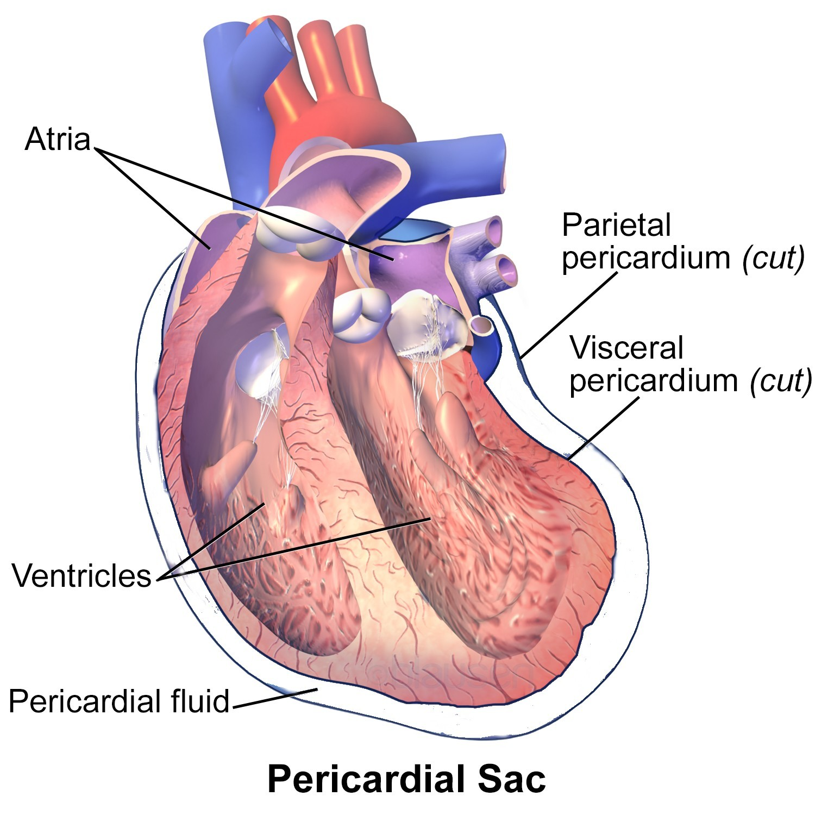
Simple Squamous Epithelia
Two special simple squamous epithelia have specialized names that reflect their locations
Endothelium:
lines the inner surface of the blood vessels, lymphatic vessels, and the heart (low friction), capillaries only have endothelium – exchange of nutrients and waste between blood and tissue
derived from ectoderm and endoderm in the early embryo
Mesothelium:
Form serous membranes - surround pericardium, peritoneum, pleura and internal reproductive organs (covers the organs' outer surfaces)
derived from mesoderm
Two membrane system with fluid in between (function?)

Slide 26
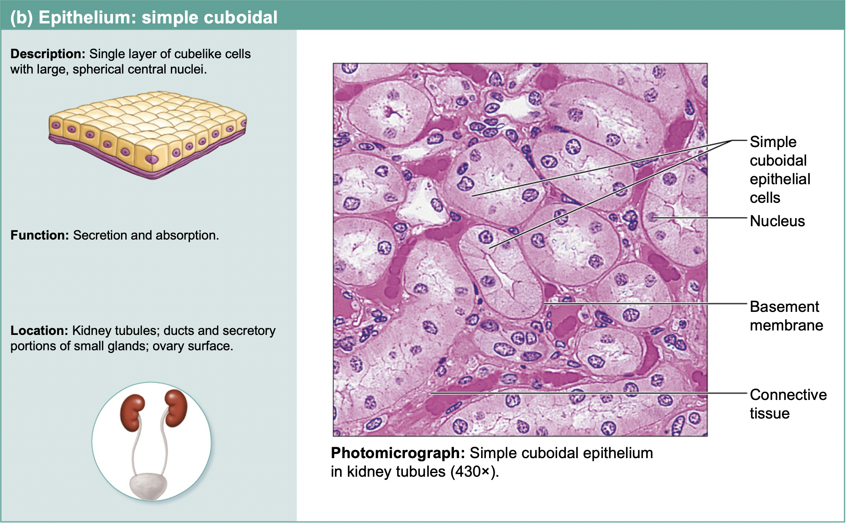

Epithelium: Simple Cuboidal
Centrally located, round nuclei
Can have cilia

Slide 27
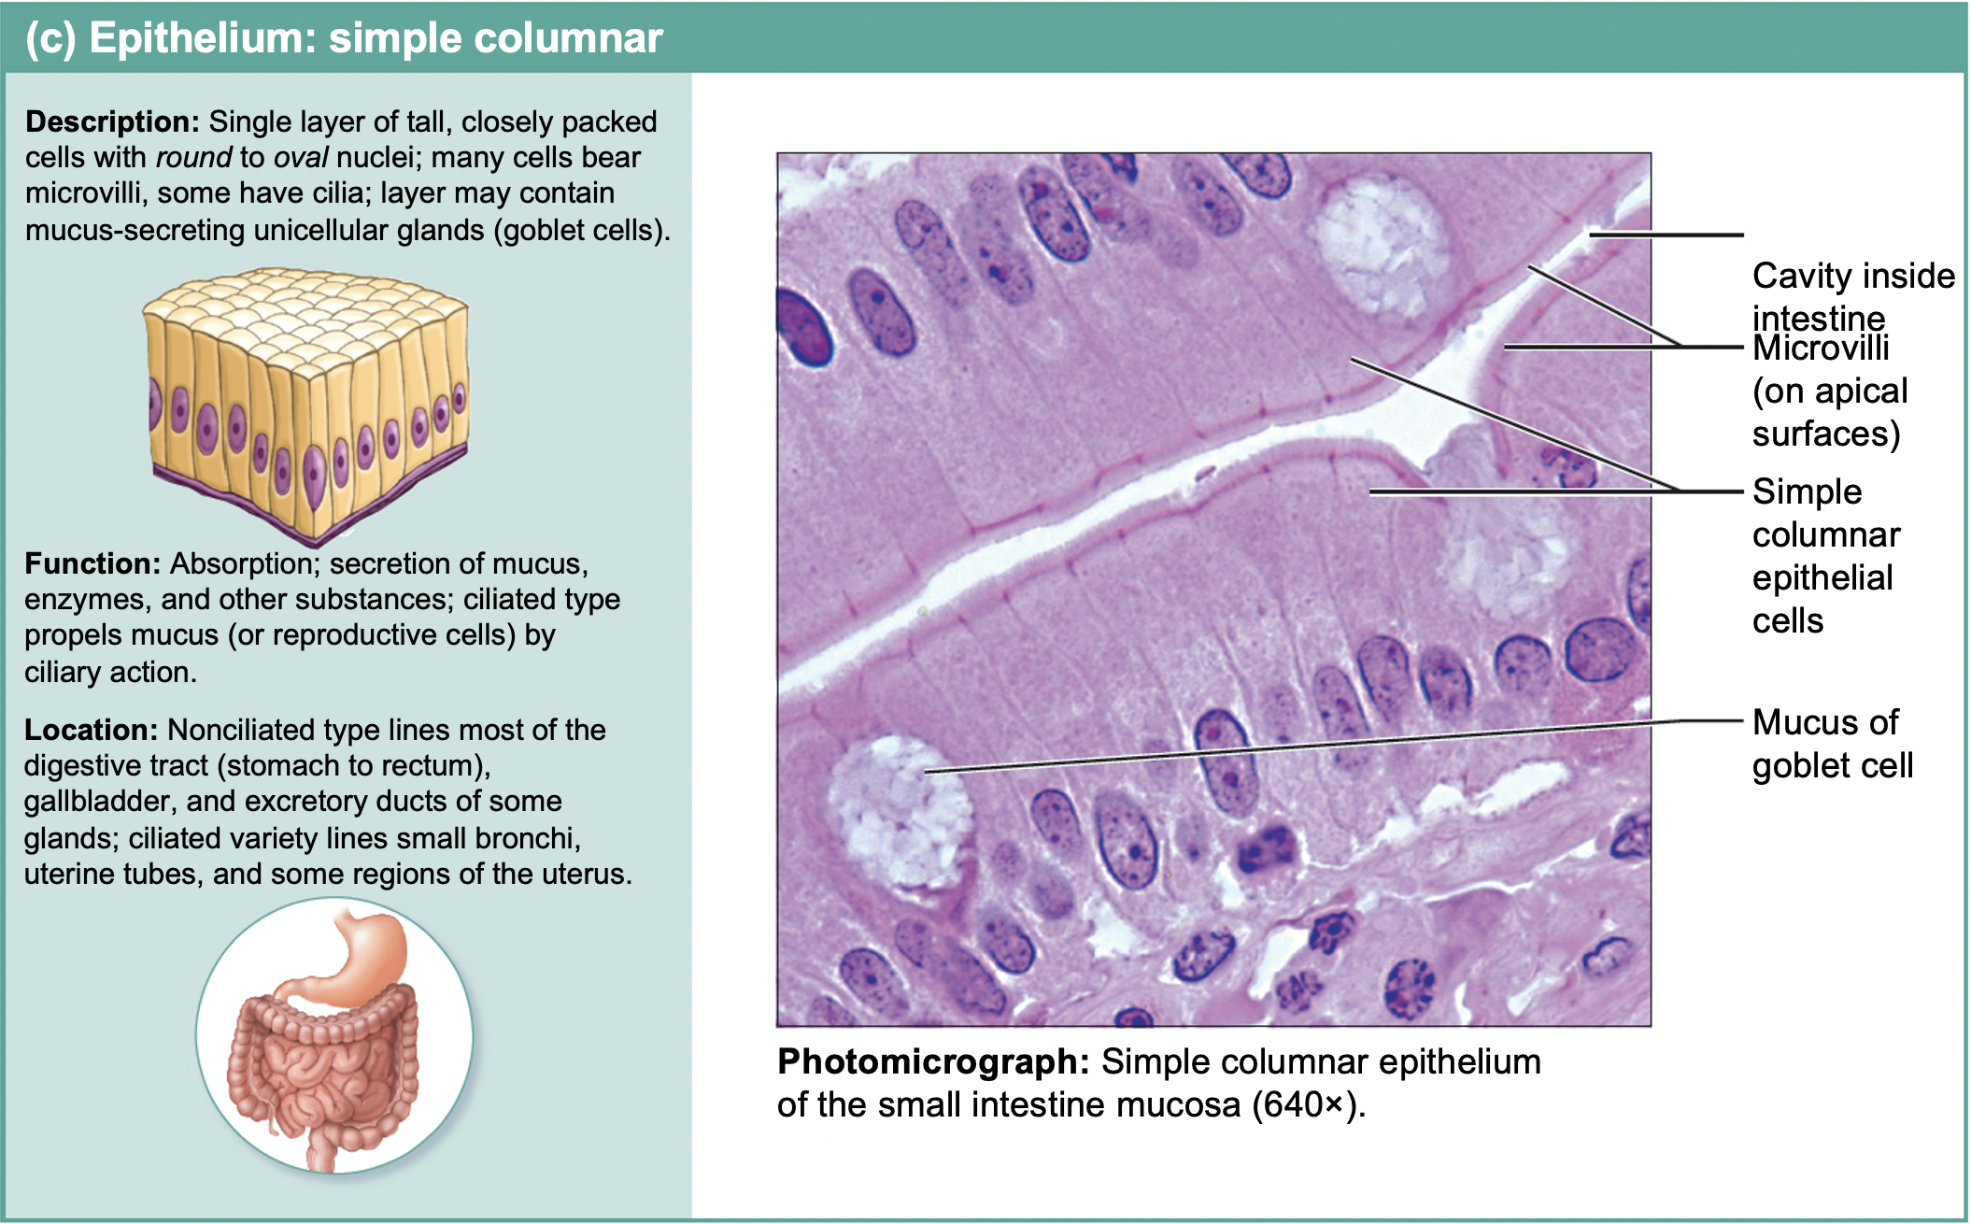
Epithelium: Simple Columnar

Slide 28
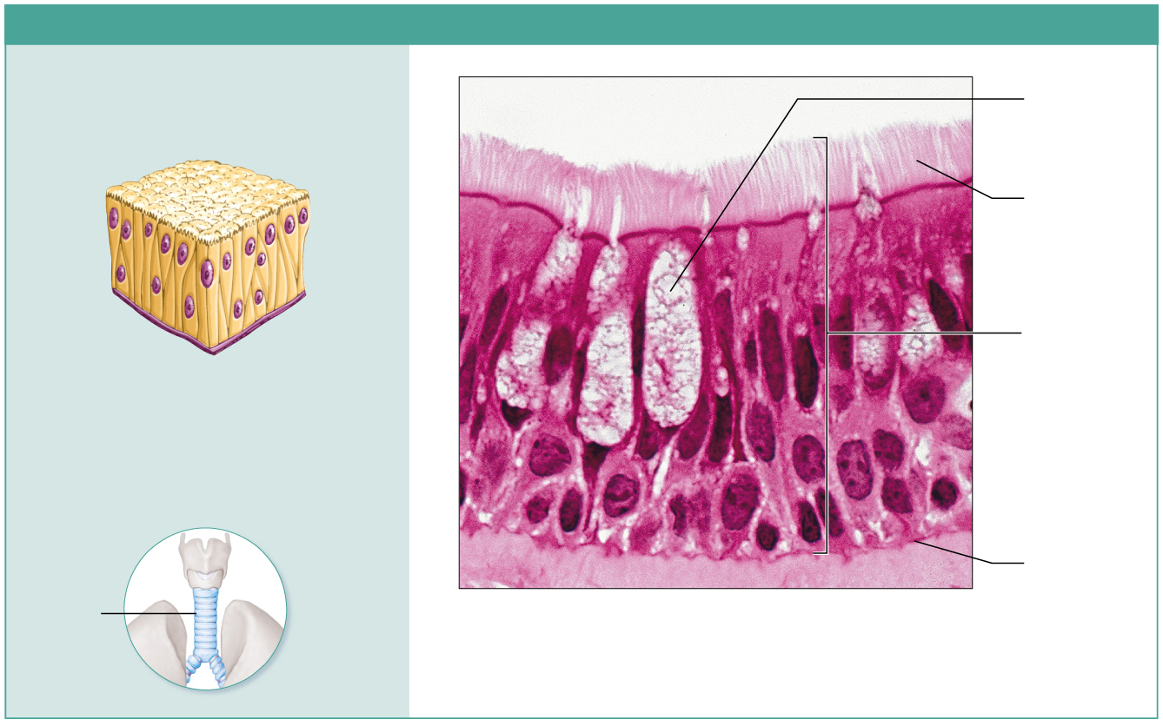
Epithelium: Pseudostratified Columnar
(d) Epithelium: pseudostratified columnar
Description: Single layer of cells of differing
heights, some not reaching the free surface;
nuclei seen at different levels; may contain
mucus-secreting cells and bear cilia.
“Pseudo” means false; Many cells are ciliated
Goblet cell
(contains
mucus)
Cilia
Pseudo-stratified
epithelial
layer
Function: Secrete substances, particularly
mucus; propulsion of mucus by ciliary action.
Location: Ciliated variety lines the trachea and
most of the upper respiratory tract; nonciliated
type in males’ sperm-carrying ducts and ducts
of large glands.
Basement
membrane
Trachea
Photomicrograph: Pseudostratified ciliated
columnar epithelium lining the human trachea (780×).
Cells vary in height and appear to be multi-layered and stratified, but tissue is in fact single-layered simple epithelium

Slide 29
Stratified Epithelia
Have two or more layers of cells
New cells regenerate from below
Basal cells divide and migrate toward surface
More durable than simple epithelia because protection is the major role

Slide 30
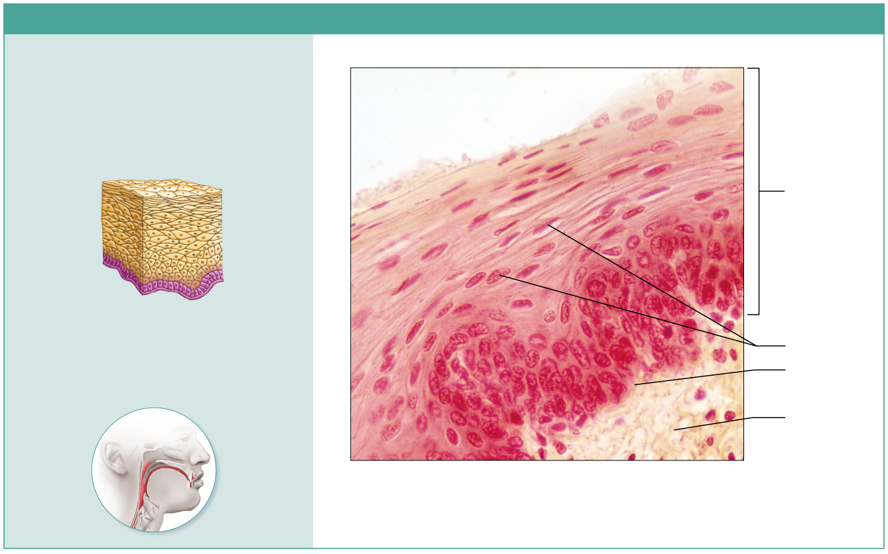
Stratified Squamous Epithelium
(e) Epithelium: stratified squamous
Description: Thick epithelium composed of
several cell layers; basal cells are cuboidal or
columnar and metabolically active; surface
cells are flattened (squamous); in the
keratinized type, the surface cells are full of
keratin and dead; basal cells are active in
mitosis and produce the cells of the more
superficial layers.
Stratified
squamous
epithelium
Function: Protects underlying tissues in
areas subjected to abrasion.
Location: Nonkeratinized type forms the
moist linings of the esophagus, mouth, and
vagina; keratinized variety forms the
epidermis of the skin, a dry epithelium.
Nuclei
Basement
membrane
Connective
tissue
Photomicrograph: Stratified squamous epithelium
lining the esophagus (285×).

Slide 31
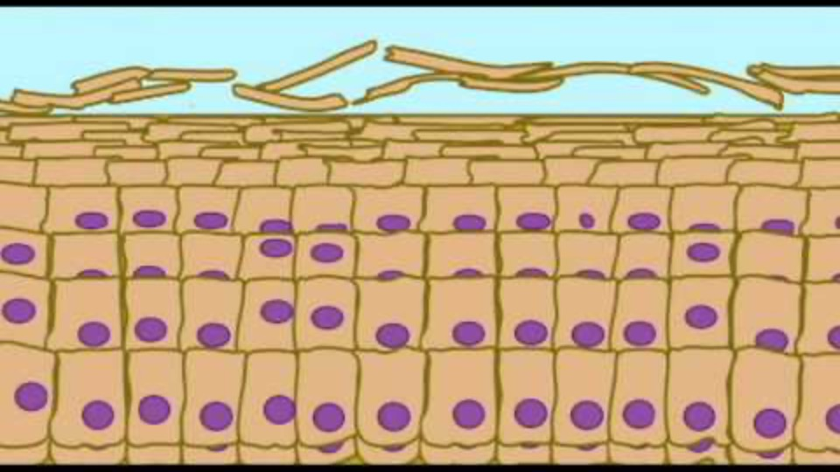
Skin Keratinization Video

Slide 32
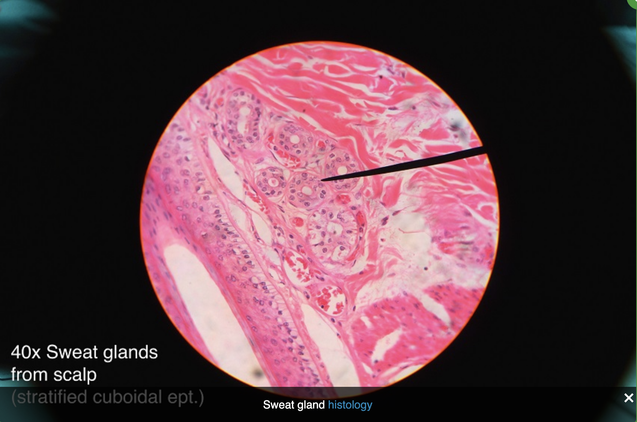
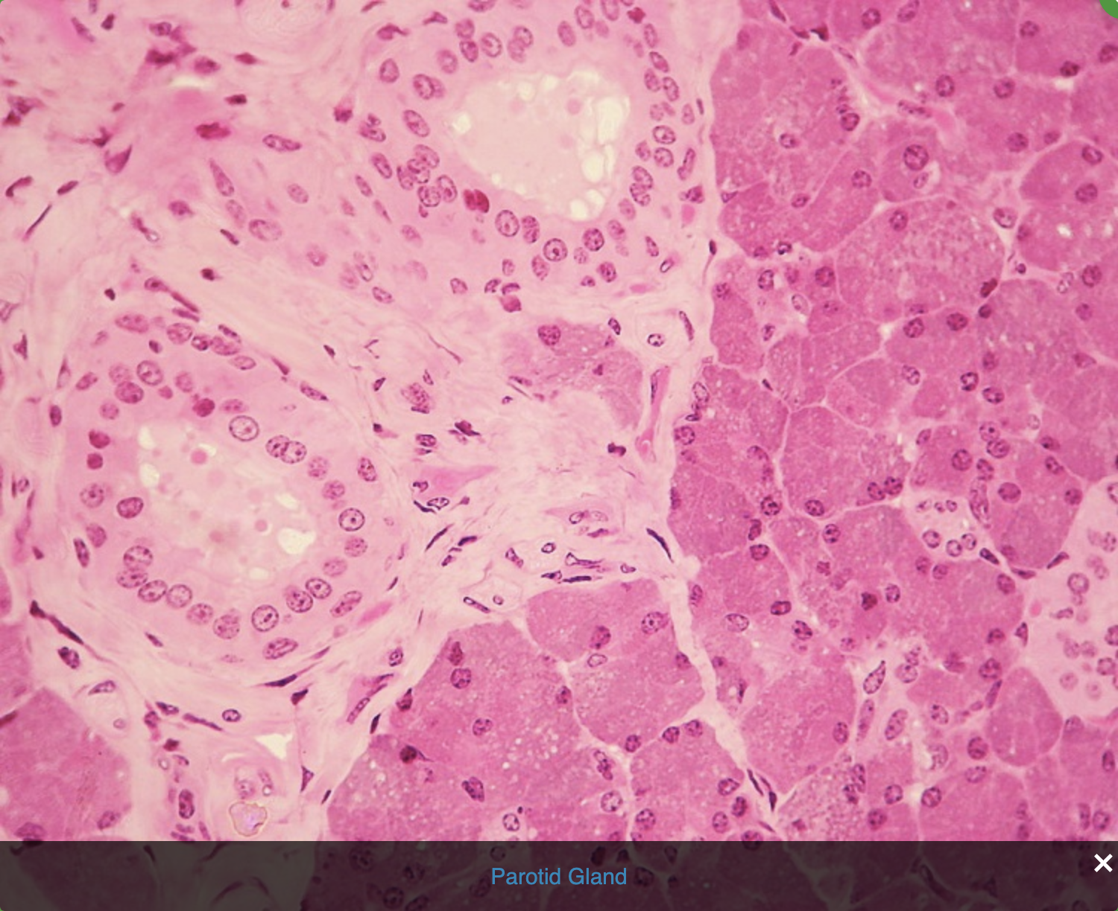
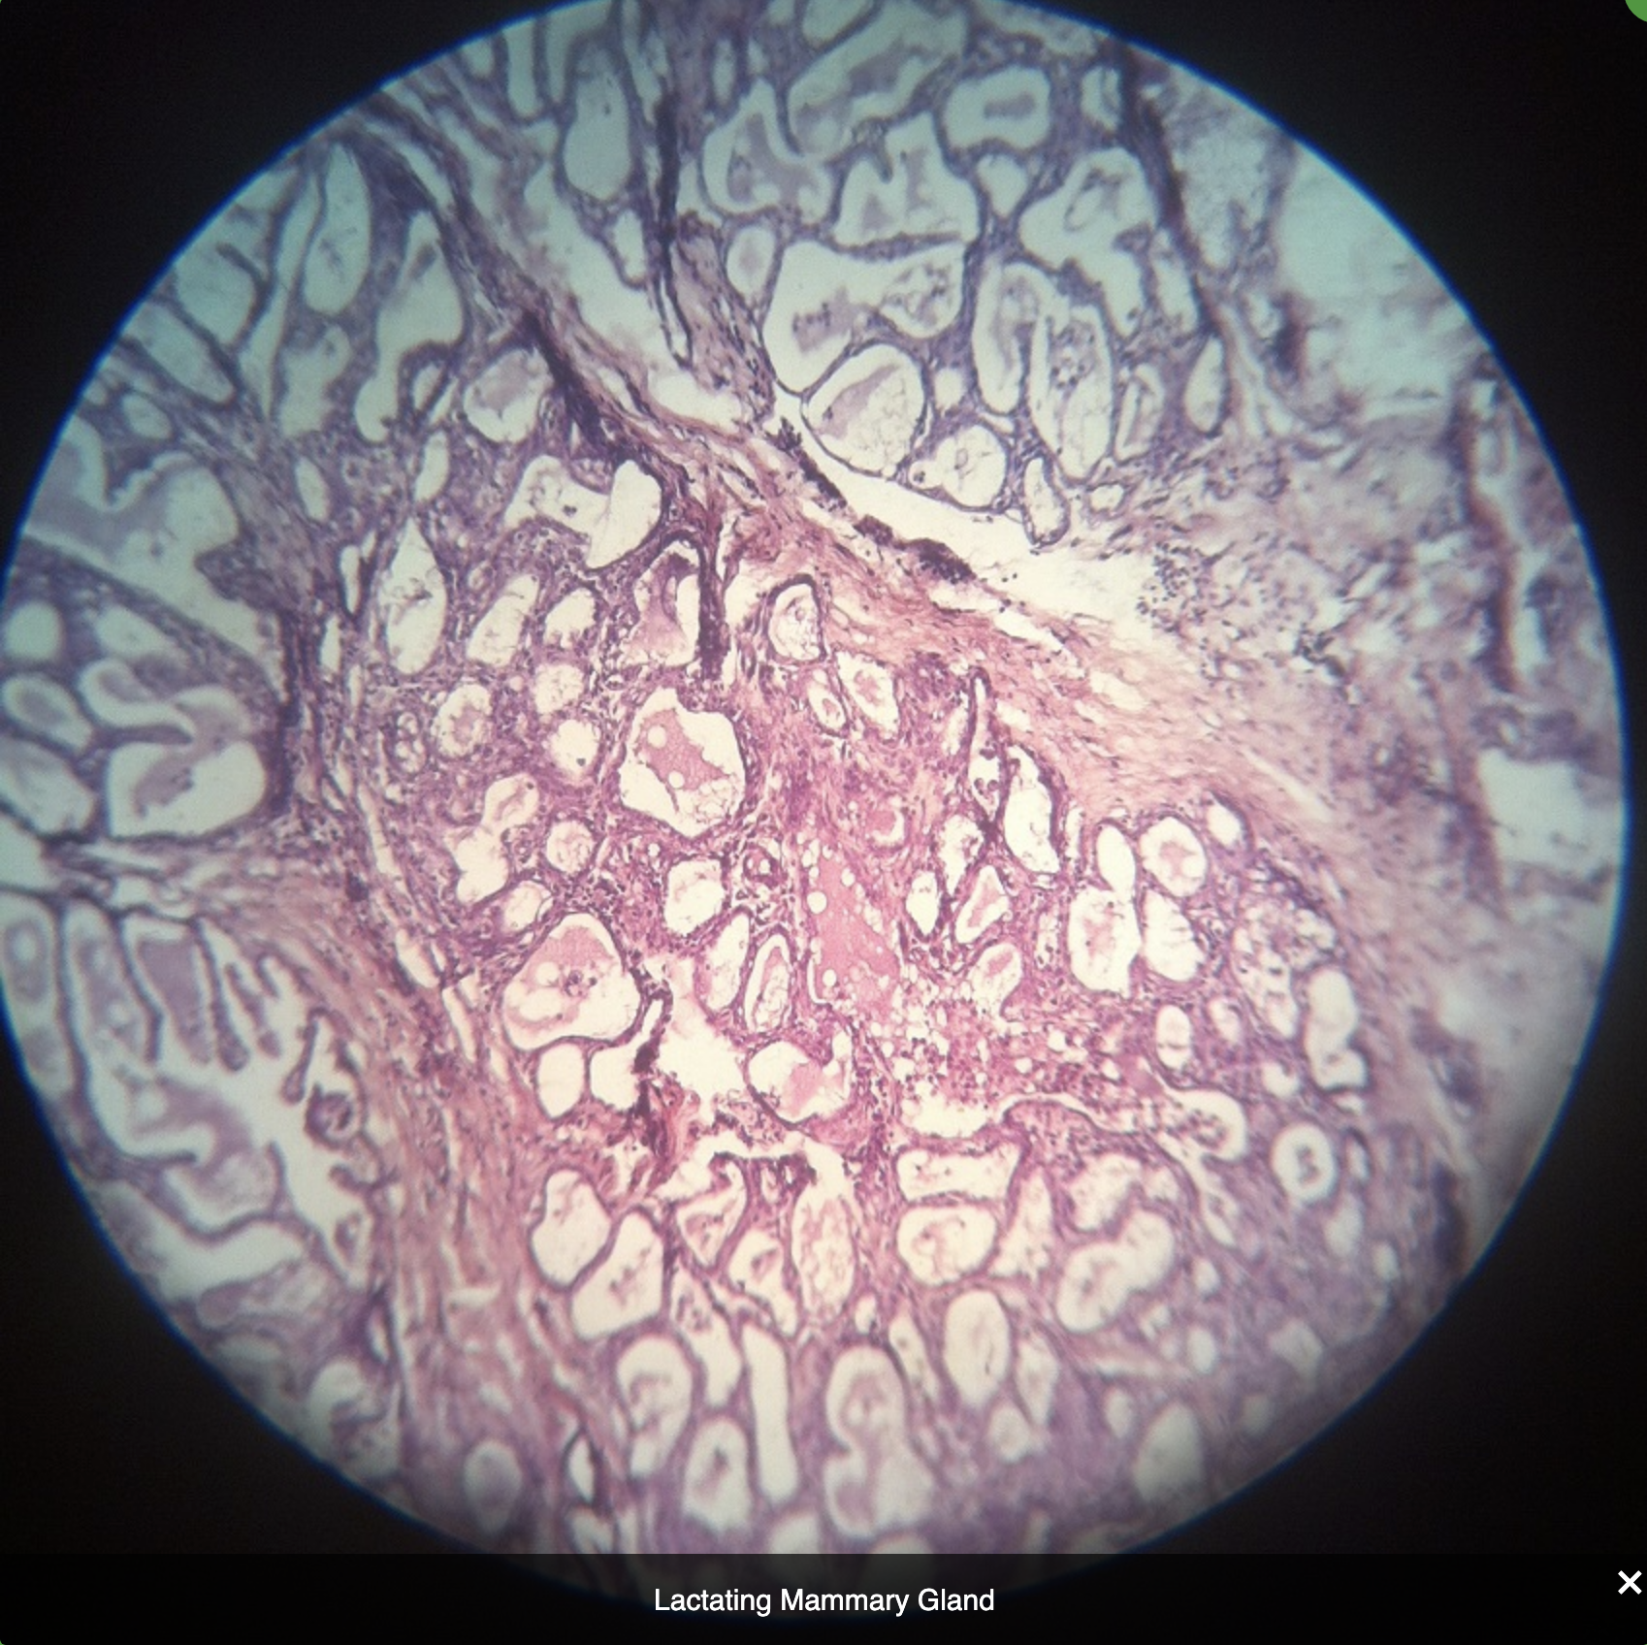
Stratified Cuboidal Epithelium
Quite rare
Mostly found in ducts of larger glands
Typically only two cell layers thick but has other, more basal layers (e.g. squamous)
Functions: protection and secretion
Sweat gland
Parotid gland
Mammary gland

Slide 33
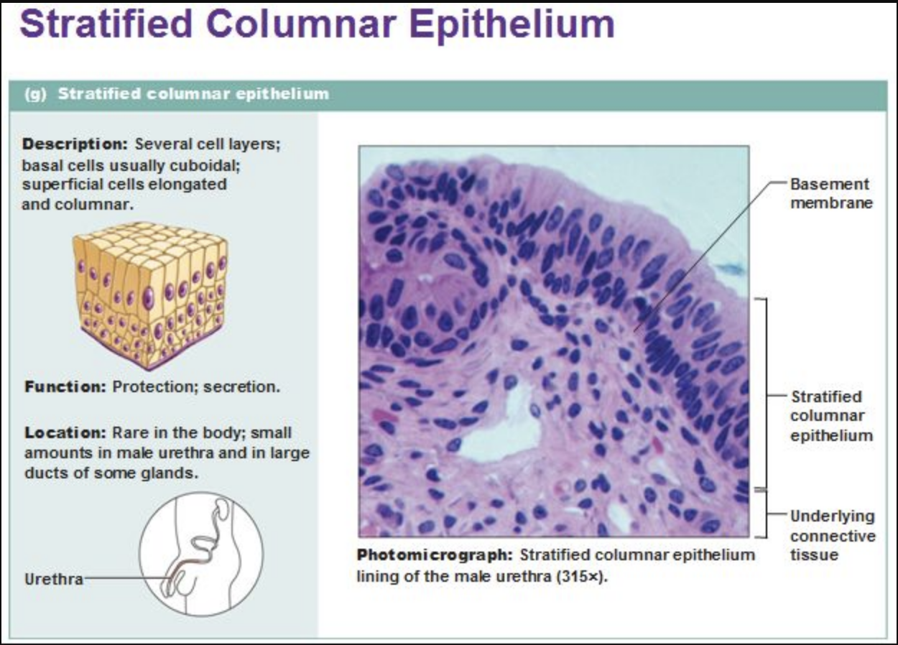
Stratified Columnar Epithelium
Also very limited distribution in body
Small amounts found in pharynx, in male urethra, and lining some glandular ducts
Usually occurs at transition areas between two other types of epithelia
Only apical layer is columnar
columnar
cuboidal

Slide 34
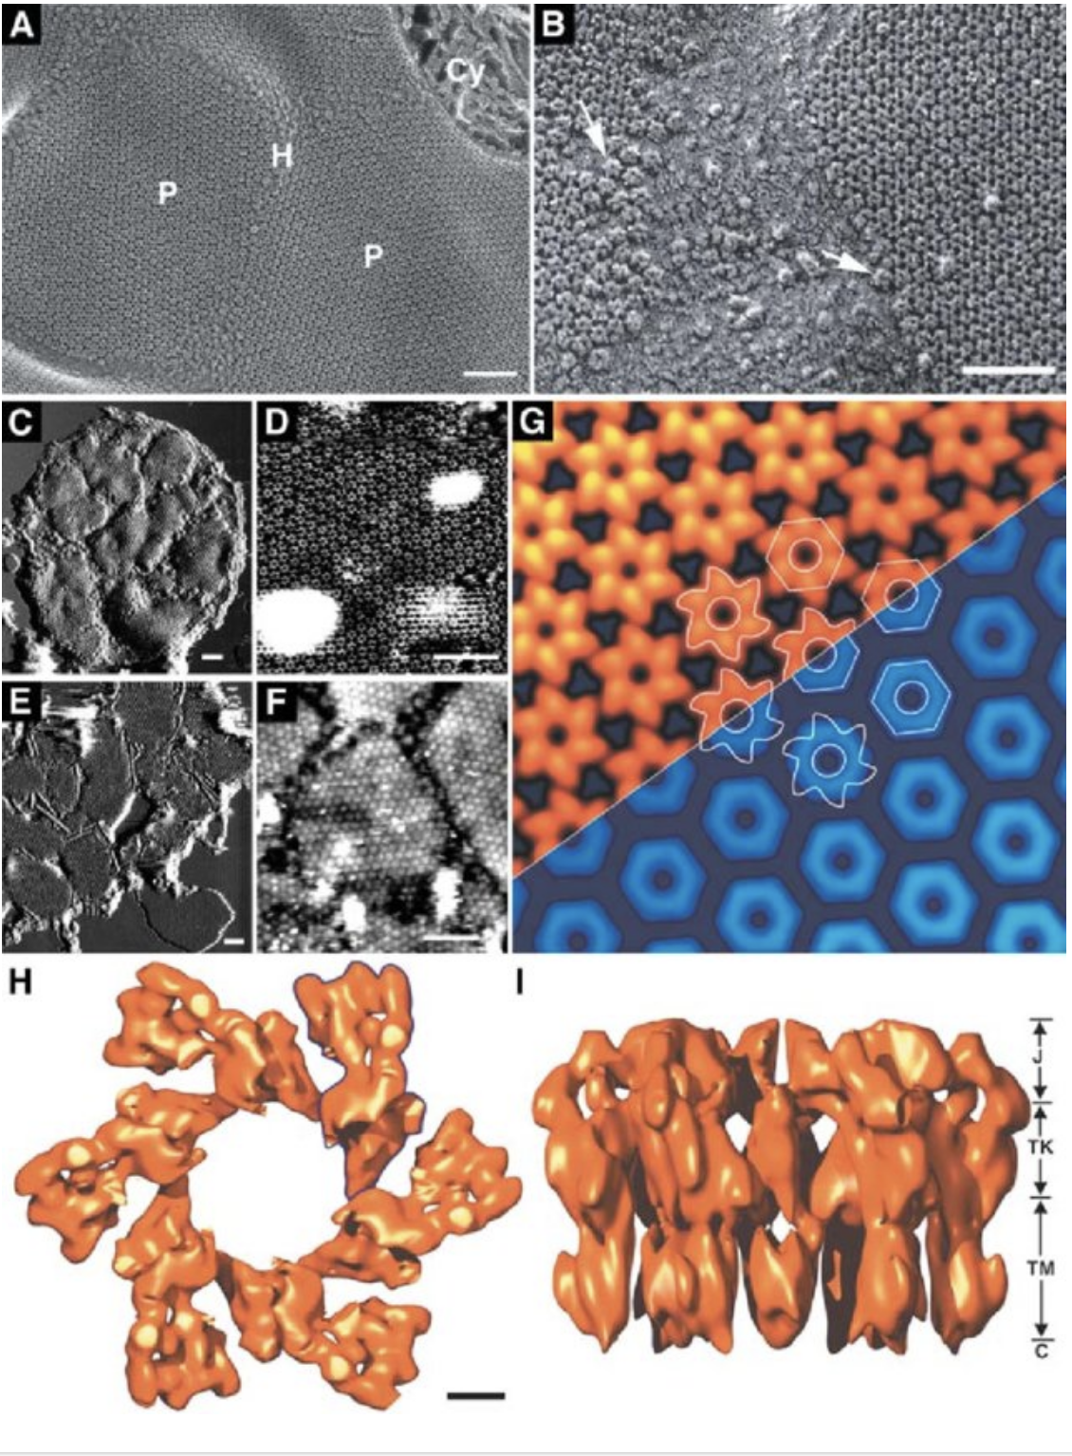
Transitional Epithelium
(f) Epithelium: transitional
plaques
uroplakin

Slide 35
Transitional Epithelium
(f) Epithelium: transitional
Relaxed
Stretched

Slide 36
Glandular Epithelia
Gland: One or more cells that makes and secretes an aqueous fluid called a secretion
Classified by:
Site of product release:
Endocrine: internally secreting (e.g. hormones)
Exocrine: externally secreting (e.g. sweat)
Relative number of cells forming the gland
Unicellular (e.g. goblet cells) or multicellular (e.g. salivary)

Slide 37
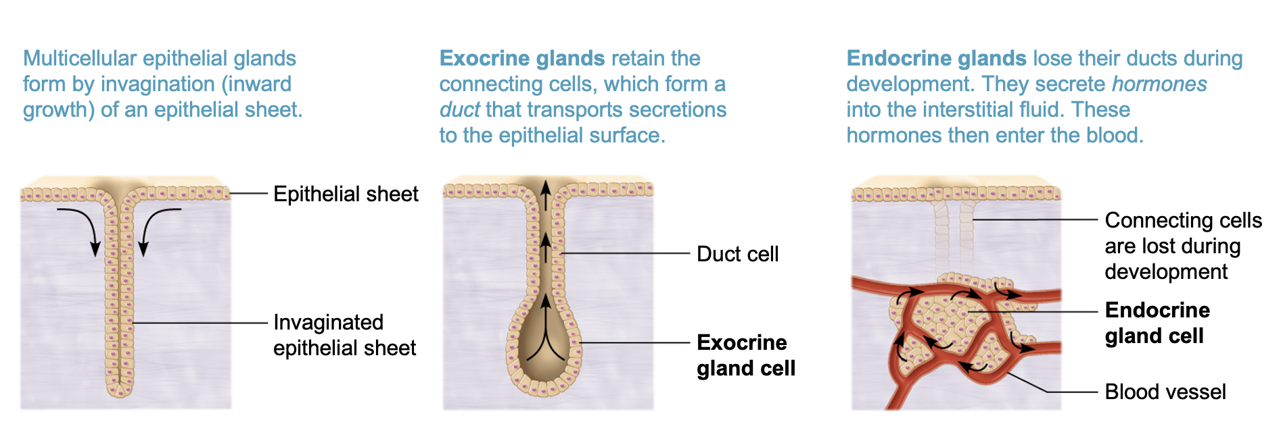
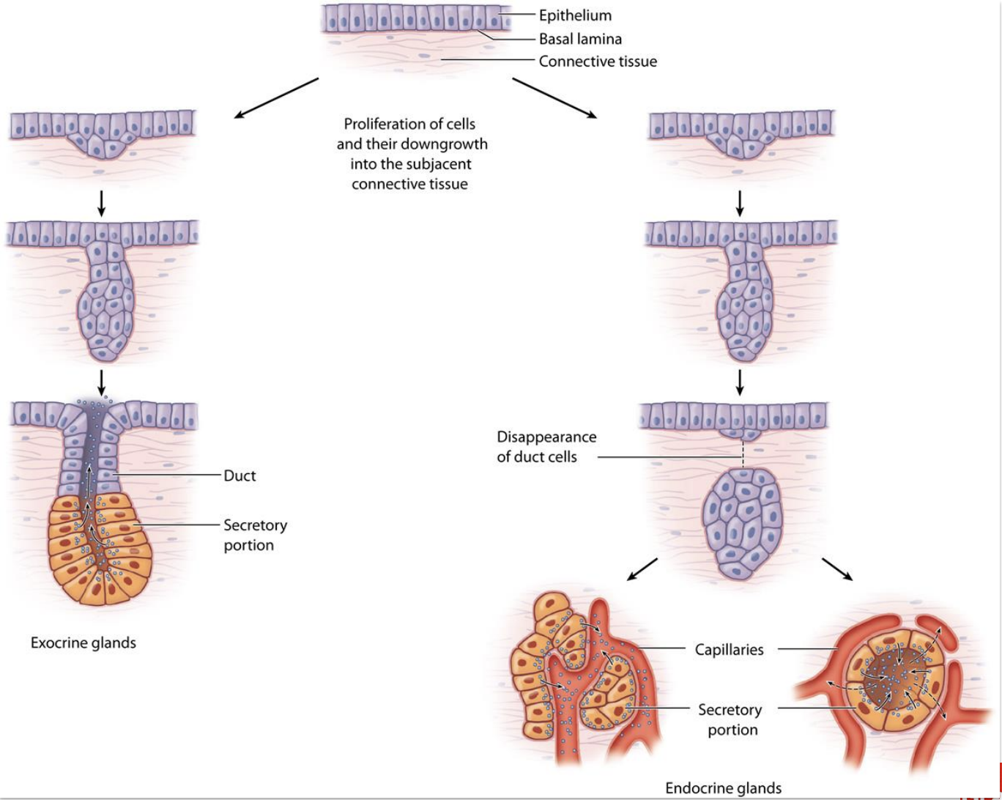
Formation of multicellular exocrine and endocrine glands

Slide 38

Endocrine glands
Ductless
Hormones: chemicals that travel through lymph or blood to target organs that respond in a characteristic way
Major glands of the endocrine system include:
Pineal gland
Pituitary gland
Pancreas
Ovaries / Testes
Thyroid and parathyroid glands
Hypothalamus
Adrenal glands

Slide 39
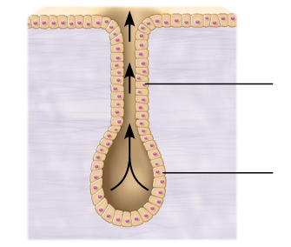
Exocrine glands
Secretions are released onto body surfaces, such as skin, or into body cavities
More numerous than endocrine glands
Secrete products into ducts
Examples include: sweat, salivary, mammary, ceruminous, lacrimal, sebaceous, prostate, pancreas, and liver.
Can be:
Unicellular
Multicellular

Slide 40
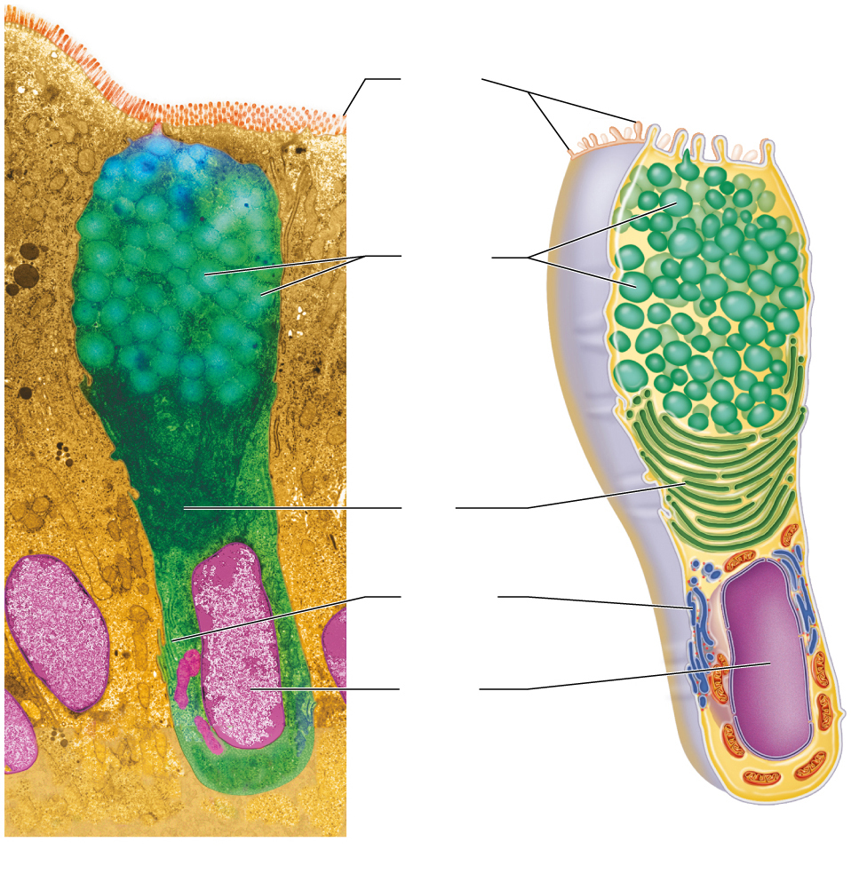
Unicellular exocrine gland
Microvilli
Unicellular exocrine glands
The only important unicellular glands are mucous cells and goblet cells
Found in epithelial linings of intestinal and respiratory tracts among columnar cells
All produce mucin, a sugar-protein that can dissolve in water to form mucus, a slimy protective, lubricating coating (protects from what?)
Secretory
vesicles
containing
mucin
Golgi
apparatus
Rough ER
Nucleus
(a)
(b)

Slide 41
Multicellular exocrine glands
composed of a duct and a secretory unit
Usually surrounded by supportive connective tissue that supplies blood and innervation
Connective tissue can form capsule around gland, and also extend into gland, dividing it into lobes
Classified by:
Structure
Mode of secretion

Slide 42
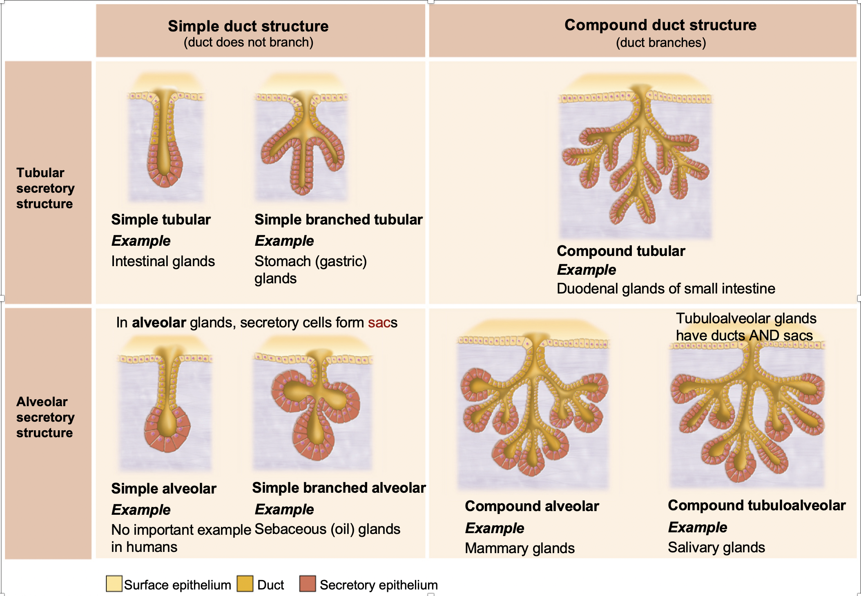
Structural classification of multicellular exocrine glands

Slide 43
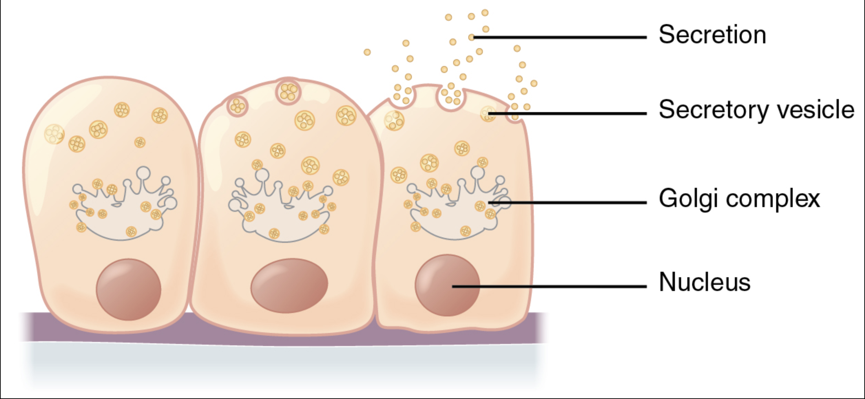
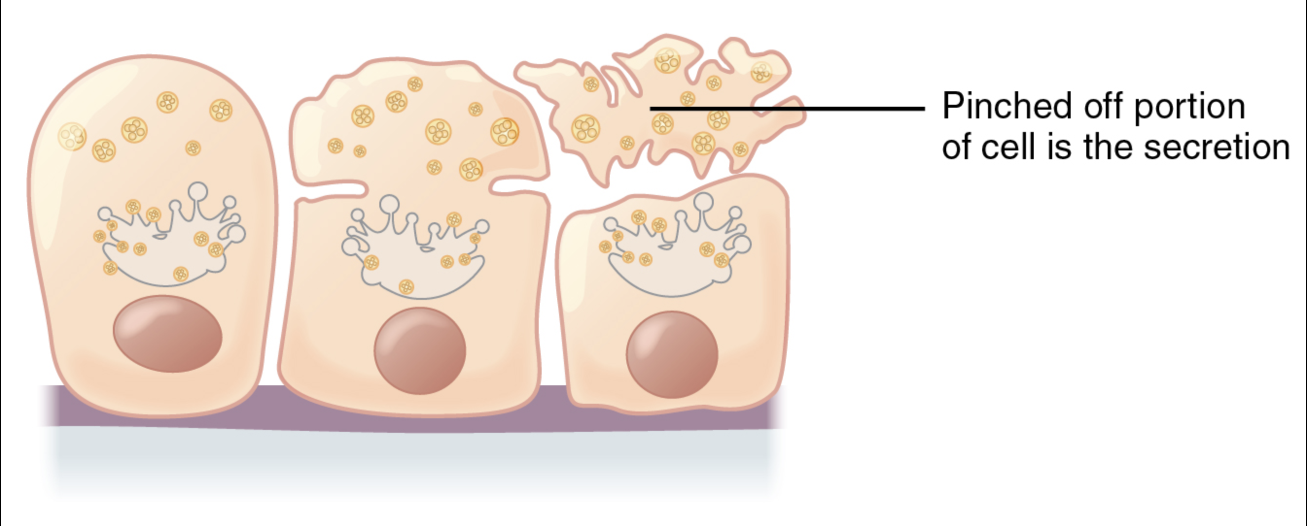
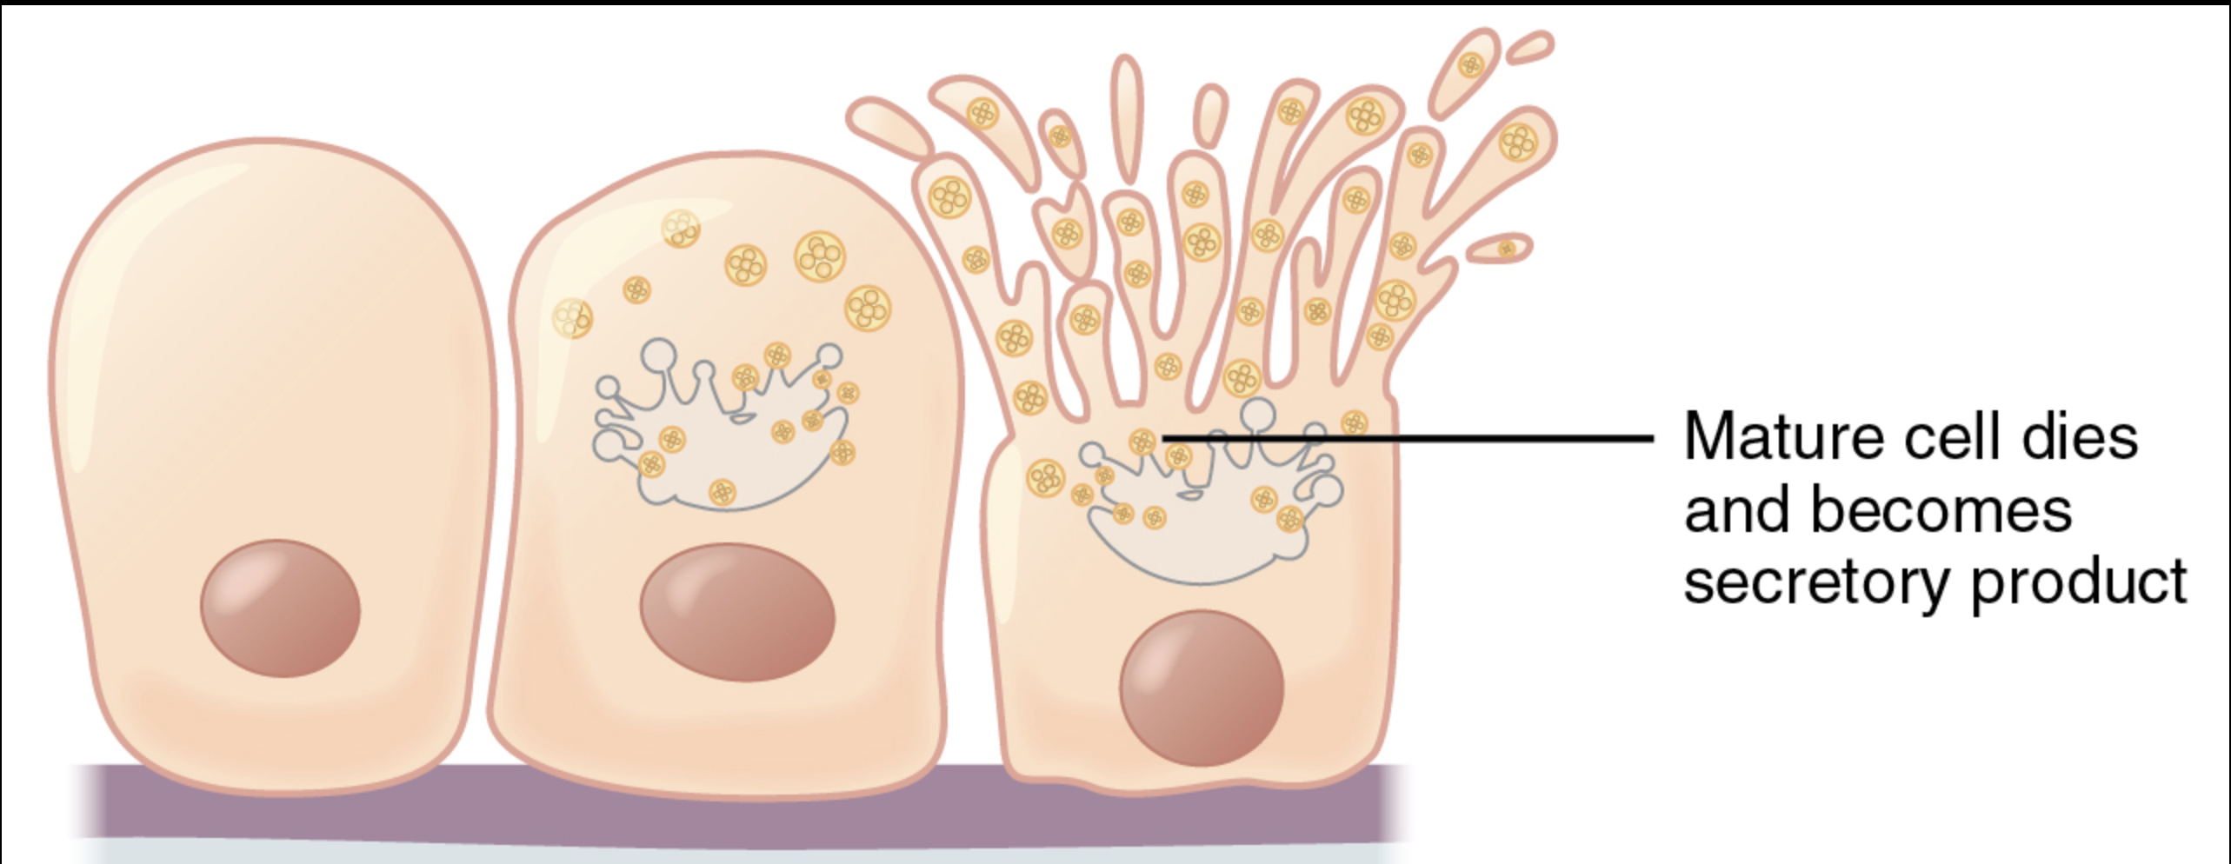
Mechanisms of secretion in human exocrine glands
Merocrine (eccrine) glands secrete their
products by exocytosis as they are produced
(most sweat glands, pancreas).
In apocrine glands the secretory cells accumulate products just beneath the cell surface facing the duct; only the apex of the cell breaks off (sweat glands associated with hairy body parts).
In holocrine glands, the entire secretory cell ruptures, releasing secretions and dead cell fragments (sebaceous oil glands).

Slide 44
Apocrine sweat glands

Slide 45
© 2020 Stephen Gee
All Rights Reserved
You can revisit this or any other lecture anytime by visiting https://echo360.org.uk/section/a0b9f1cf-411a-4183-a7b7-07b938aa51db/home

Slide 46
Credits
Surface Area to Volume Ratio Explained by Science Sauce http://sciencesauceonline.com
SKIN: KERATINIZATION IN EPIDERMIS by Walter Jahn (https://www.youtube.com/channel/UC349sMjOUYTjIDKrLGkieqQ)
Forrest Gump (https://youtu.be/7-Yr1nQ3dFI)

Slide 47
FIN

